Slide 1
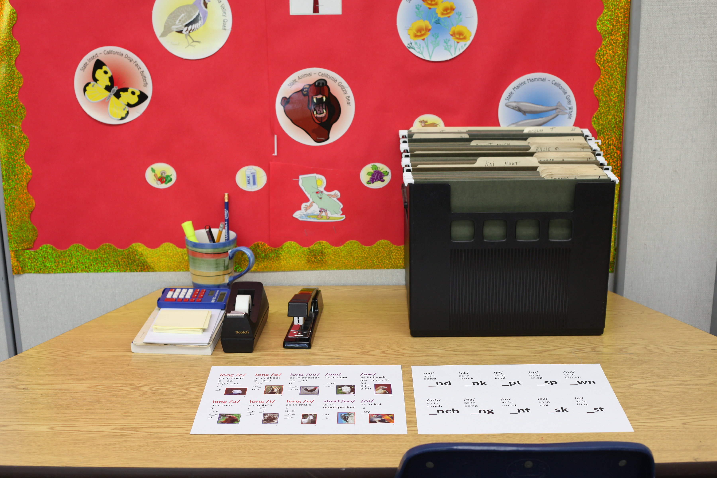
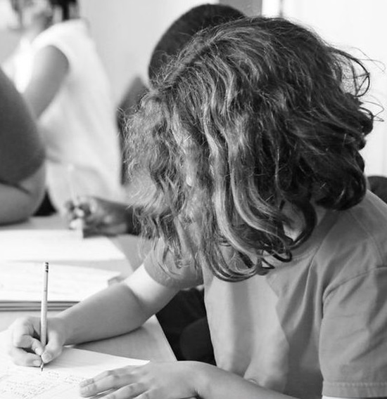
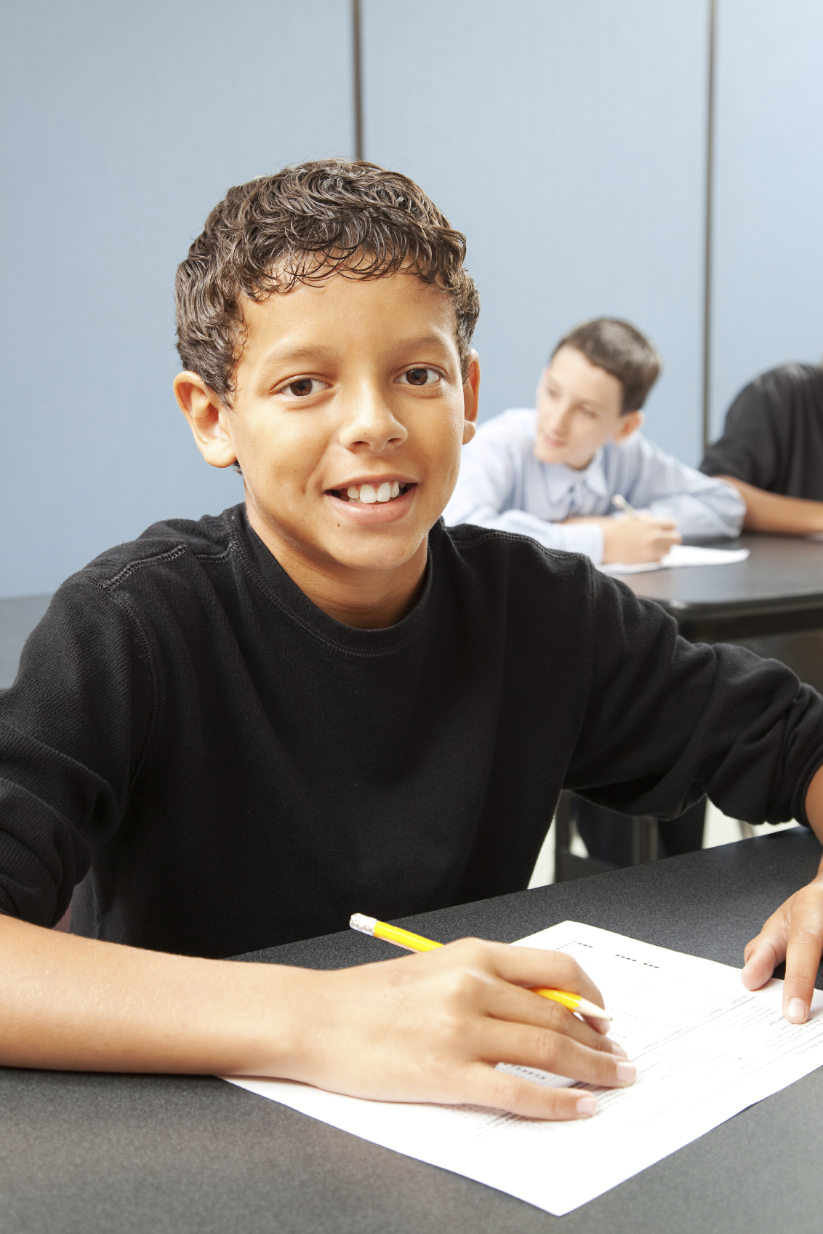
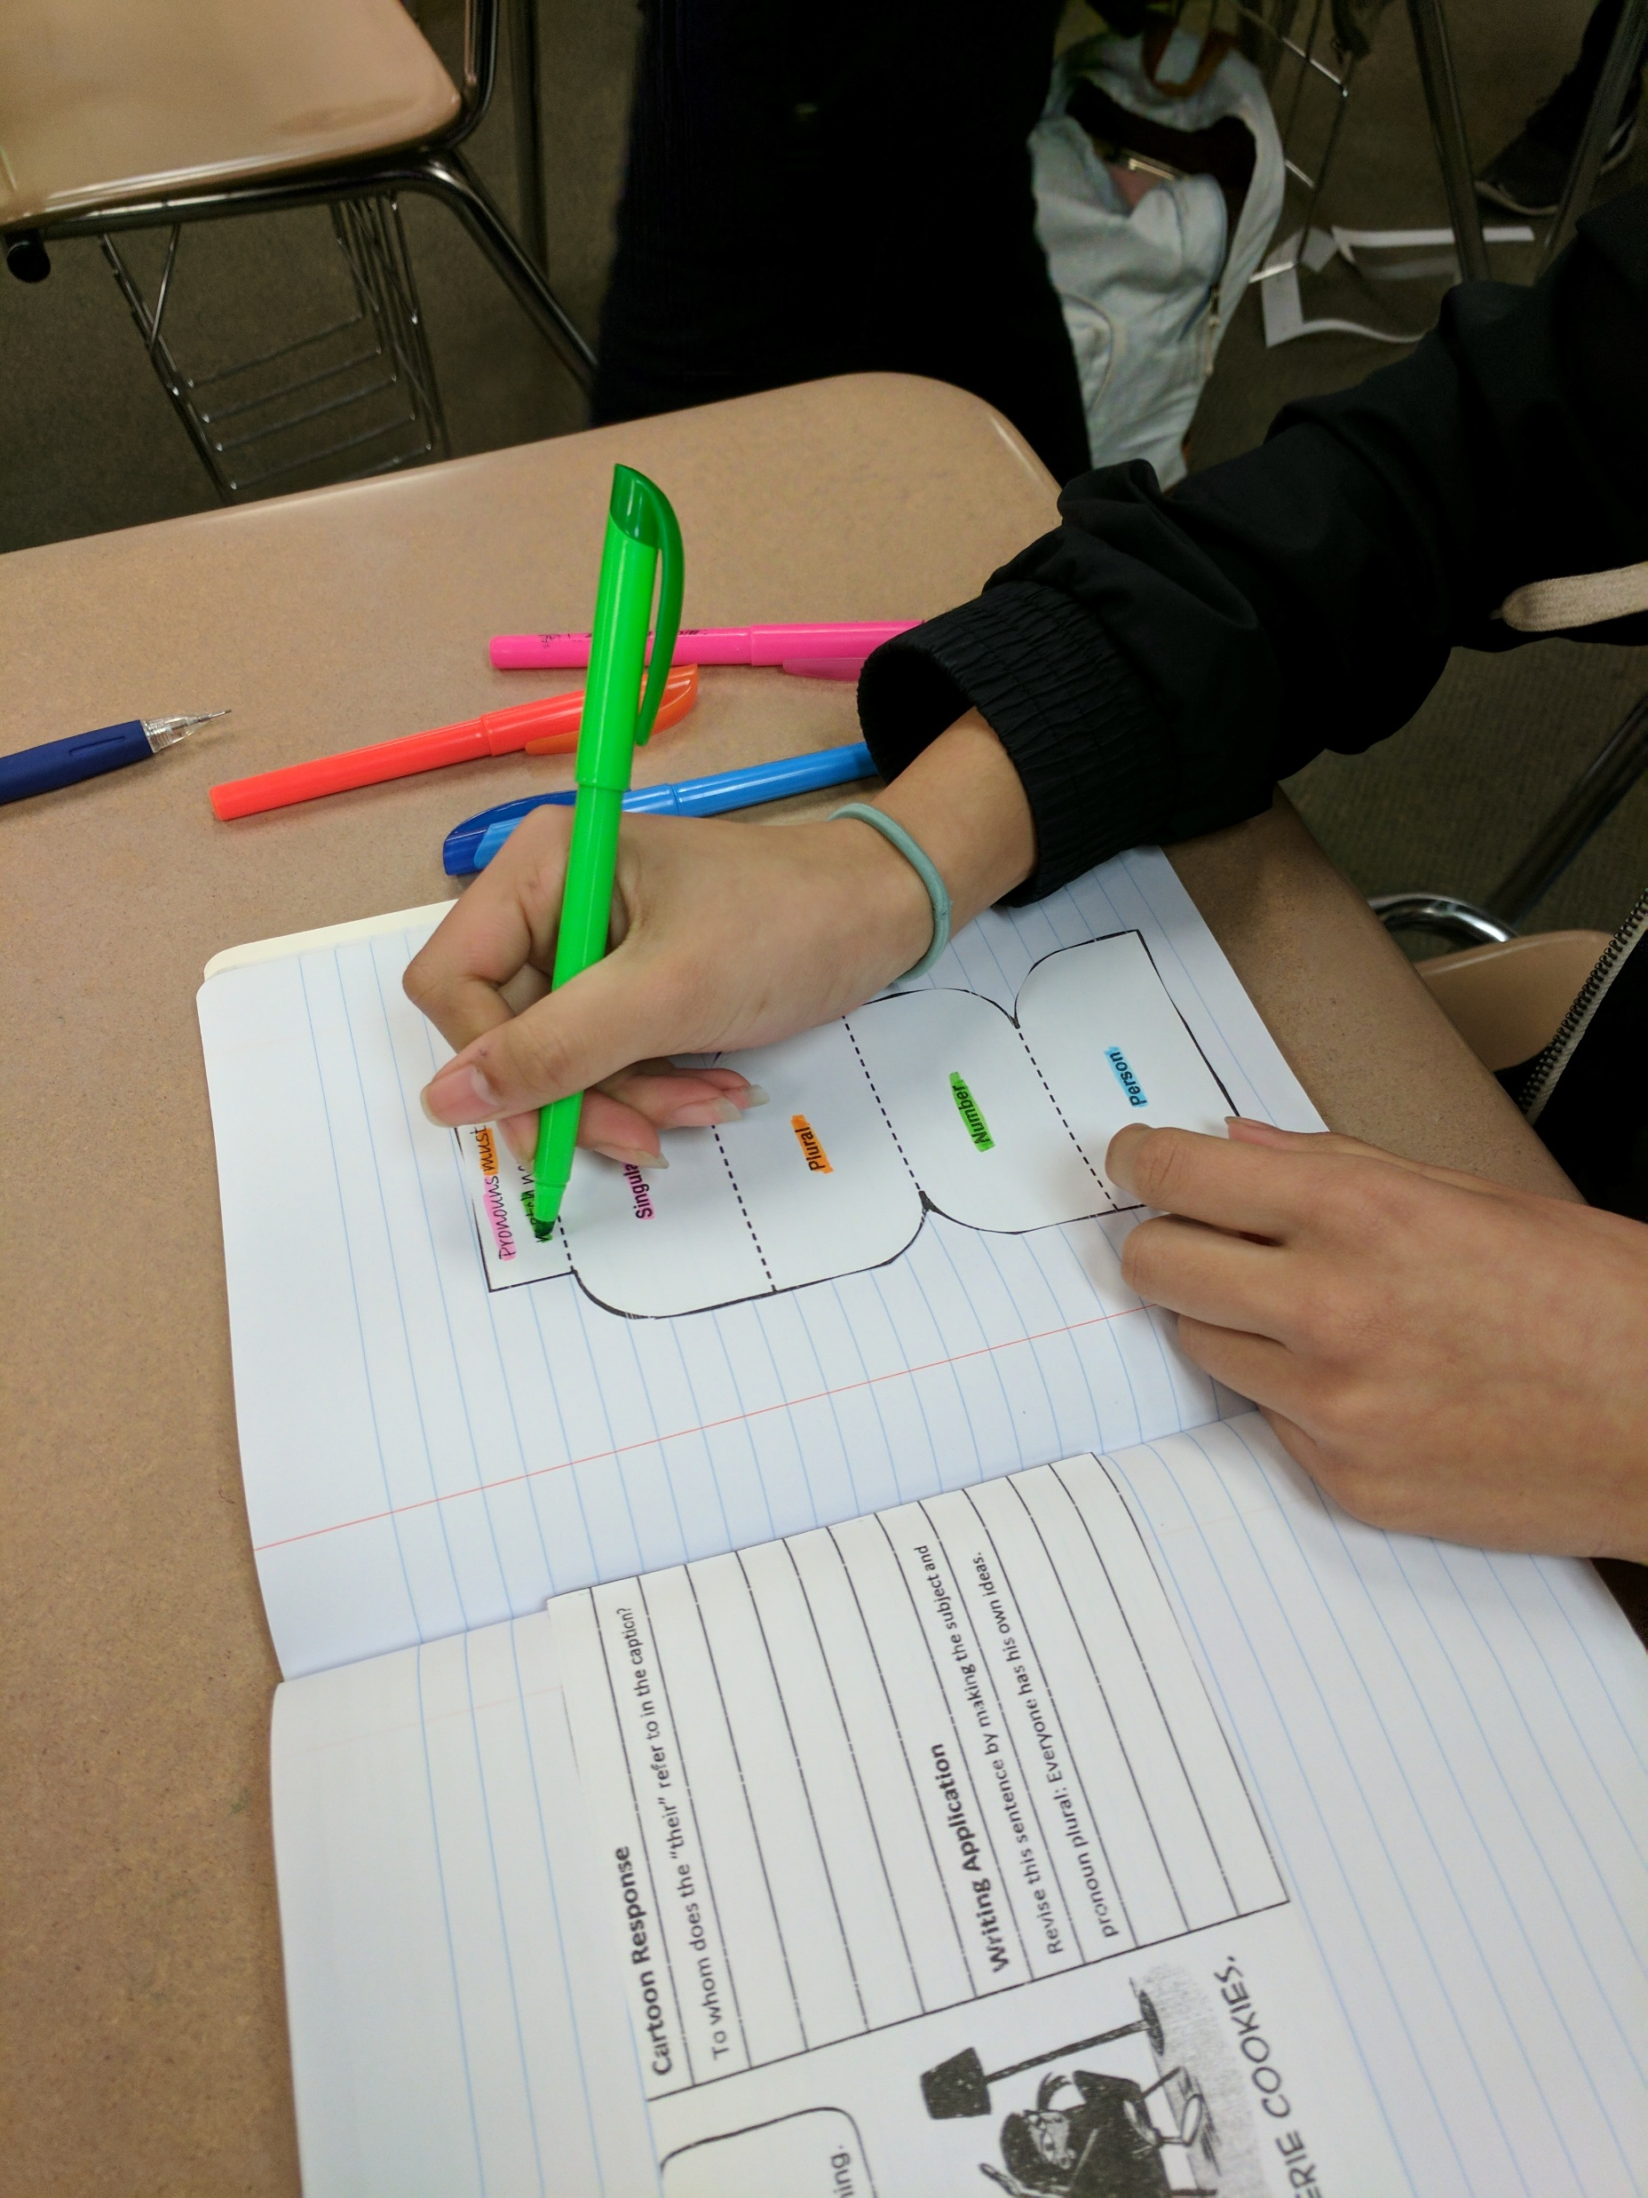
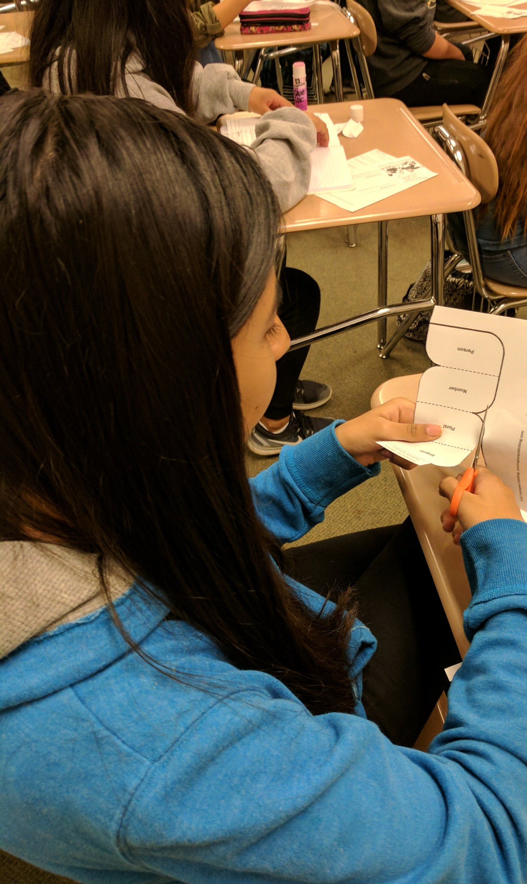
Remedial
Grammar, Usage, and Mechanics
Literacy
Center
Grades 4,5,6,7,8
Diagnostic Gram Assessments
77 Grammar, Usage, and Mechanics Remedial Literacy Center Lessons
Formative Assessments
Alligned to the Common Core Standards

Slide 2
Phonics
Literacy
Center
Grades 4,5,6,7,8
Diagnostic Assessments
35 Phonics Lessons and Activities
Formative Assessments
Phonics Card Games

Slide 3
Academic
Literacy
Centers
Grades 4,5,6,7,8
Reading
Writing
Language Conventions
Vocabulary
Spelling and Syllabicaton
Study Skills
Alligned to the Common Core Standards

Slide 4
Language
Conventions
Academic
Literacy
Center
Grades 4,5,6,7,8
56 Grammar and Mechanics Lessons
Cornell Notes
Practice with Answers
Online Links and Resources
Alligned to the Common Core Standards

Slide 5
Study Skills
Academic
Literacy
Center
Grades 4,5,6,7,8
How to...
Get Motivated and Set Goals
Get Organized
Manage Homework Time
Learn Reading and Writing Strategies
Memorize and Study for Tests
Listen and Take Notes
Learn Grammar and Mechanics Rules
Alligned to the Common Core Standards

Slide 6
Reading
Academic
Literacy
Center
Grades 4,5,6,7,8
48 Reading Comprehension Strategy Articles at Grades 3, 5, and 7 Reading Levels
Vocabulary in Context
5 Higher Level Comprehension Questions per Article
Diagnostic Reading Fluency Assessment
Modeled Readings at 3 Different Fluency Speeds for Each Article
Word Counts and Timing Charts
Alligned to the Common Core Standards

Slide 7
Academic
Literacy
Centers
Grade 4
Reading
Writing
Language Conventions
Vocabulary
Spelling and Syllabicaton
Study Skills
Alligned to the Common Core Standards

Slide 8
Academic
Literacy
Centers
Grade 5
Reading
Writing
Language Conventions
Vocabulary
Spelling and Syllabicaton
Study Skills
Alligned to the Common Core Standards

Slide 9
Academic
Literacy
Centers
Grade 6
Reading
Writing
Language Conventions
Vocabulary
Spelling and Syllabicaton
Study Skills
Alligned to the Common Core Standards

Slide 10
Academic
Literacy
Centers
Grade 7
Reading
Writing
Language Conventions
Vocabulary
Spelling and Syllabicaton
Study Skills
Alligned to the Common Core Standards

Slide 11
BUNDLE
Remedial
Literacy
Centers
Grades 4,5,6,7,8
Spelling
Grammar, Usage, and Mechanics
Phonics
Sam and Friends Guided Reading Phonics Books
INTERVENTION
Students catch up while they keep up with grade-level instruction.
Alligned to the Common Core Standards

Slide 12
BUNDLE
Academic
Literacy
Centers
Grade 4
Reading
Writing
Language Conventions
Vocabulary
Spelling and Syllabicaton
Study Skills
Alligned to the Common Core Standards

Slide 13
BUNDLE
Academic
Literacy
Centers
Grade 5
Reading
Writing
Language Conventions
Vocabulary
Spelling and Syllabicaton
Study Skills
Alligned to the Common Core Standards

Slide 14
BUNDLE
Academic
Literacy
Centers
Grade 6
Reading
Writing
Language Conventions
Vocabulary
Spelling and Syllabicaton
Study Skills
Alligned to the Common Core Standards

Slide 15
BUNDLE
Academic
Literacy
Centers
Grade 7
Reading
Writing
Language Conventions
Vocabulary
Spelling and Syllabicaton
Study Skills
Alligned to the Common Core Standards

Slide 16
BUNDLE
Academic
Literacy
Centers
Grade 8
Reading
Writing
Language Conventions
Vocabulary
Spelling and Syllabicaton
Study Skills
Alligned to the Common Core Standards

Slide 17
BUNDLE
Academic
Literacy
Centers
Grade 5
Reading
Writing
Language Conventions
Vocabulary
Spelling and Syllabicaton
Study Skills
Alligned to the Common Core Standards

Slide 18
BUNDLE
Academic
Literacy
Centers
Grade 6
Reading
Writing
Language Conventions
Vocabulary
Spelling and Syllabicaton
Study Skills
Alligned to the Common Core Standards

Slide 19
BUNDLE
Academic
Literacy
Centers
Grade 7
Reading
Writing
Language Conventions
Vocabulary
Spelling and Syllabicaton
Study Skills
Alligned to the Common Core Standards

Slide 20
BUNDLE
Academic
Literacy
Centers
Grade 8
Reading
Writing
Language Conventions
Vocabulary
Spelling and Syllabicaton
Study Skills
Alligned to the Common Core Standards

Slide 21
MEGA BUNDLE
Academic
Literacy
Centers
Grade 4
Reading
Writing
Language Conventions
Vocabulary
Spelling and Syllabicaton
Study Skills
Remedial Grammar and Mechanics
Sam and Friends Guided Reading Phonics Books
Remedial Spelling
Phonics
Full Year Literacy Centers with Diagnostic Assessments and
Unit Tests
Alligned to the Common Core Standards

Slide 22
MEGA BUNDLE
Academic
Literacy
Centers
Grade 5
Reading
Writing
Language Conventions
Vocabulary
Spelling and Syllabicaton
Study Skills
Remedial Grammar and Mechanics
Sam and Friends Guided Reading Phonics Books
Remedial Spelling
Phonics
Full Year Literacy Centers with Diagnostic Assessments and
Unit Tests
Alligned to the Common Core Standards

Slide 23
MEGA BUNDLE
Academic
Literacy
Centers
Grade 6
Reading
Writing
Language Conventions
Vocabulary
Spelling and Syllabicaton
Study Skills
Remedial Grammar and Mechanics
Sam and Friends Guided Reading Phonics Books
Remedial Spelling
Phonics
Full Year Literacy Centers with Diagnostic Assessments and
Unit Tests
Alligned to the Common Core Standards

Slide 24
MEGA BUNDLE
Academic
Literacy
Centers
Grade 7
Reading
Writing
Language Conventions
Vocabulary
Spelling and Syllabicaton
Study Skills
Remedial Grammar and Mechanics
Sam and Friends Guided Reading Phonics Books
Remedial Spelling
Phonics
Full Year Literacy Centers with Diagnostic Assessments and
Unit Tests
Alligned to the Common Core Standards

Slide 25
MEGA BUNDLE
Academic
Literacy
Centers
Grade 8
Reading
Writing
Language Conventions
Vocabulary
Spelling and Syllabicaton
Study Skills
Remedial Grammar and Mechanics
Sam and Friends Guided Reading Phonics Books
Remedial Spelling
Phonics
Full Year Literacy Centers with Diagnostic Assessments and
Unit Tests
Alligned to the Common Core Standards

Slide 26
Spelling and
Syllabication
Academic
Literacy
Center
Grade 4
28 Spelling Pattern Lessons
Spelling Sorts
28 Syllable Worksheets
Multi-Syllabic Decoding
Alligned to the Common Core Standards

Slide 27
Spelling and
Syllabication
Academic
Literacy
Center
Grade 5
28 Spelling Pattern Lessons
Spelling Sorts
28 Syllable Worksheets
Multi-Syllabic Decoding
Alligned to the Common Core Standards

Slide 28
Spelling and
Syllabication
Academic
Literacy
Center
Grade 6
28 Spelling Pattern Lessons
Spelling Sorts
28 Syllable Worksheets
Multi-Syllabic Decoding
Alligned to the Common Core Standards

Slide 29
Spelling and
Syllabication
Academic
Literacy
Center
Grade 7
28 Spelling Pattern Lessons
Spelling Sorts
28 Syllable Worksheets
Multi-Syllabic Decoding
Alligned to the Common Core Standards

Slide 30
Spelling and
Syllabication
Academic
Literacy
Center
Grade 8
28 Spelling Pattern Lessons
Spelling Sorts
28 Syllable Worksheets
Multi-Syllabic Decoding
Alligned to the Common Core Standards

Slide 31
Vocabulary
Academic
Literacy
Center
Grade 5
56 Vocabulary Worksheets
Multiple Meaning Words
Greek and Latin Word Parts
Figures of Speech
Dictionary and Thesaurus Skills
Context Clues
Semantic Spectrums
Four Square Academic Language Words
Alligned to the Common Core Standards

Slide 32
Vocabulary
Academic
Literacy
Center
Grade 6
56 Vocabulary Worksheets
Multiple Meaning Words
Greek and Latin Word Parts
Figures of Speech
Dictionary and Thesaurus Skills
Context Clues
Semantic Spectrums
Four Square Academic Language Words
Alligned to the Common Core Standards

Slide 33
Vocabulary
Academic
Literacy
Center
Grade 7
56 Vocabulary Worksheets
Multiple Meaning Words
Greek and Latin Word Parts
Figures of Speech
Dictionary and Thesaurus Skills
Context Clues
Semantic Spectrums
Four Square Academic Language Words
Alligned to the Common Core Standards

Slide 34
Vocabulary
Academic
Literacy
Center
Grade 8
56 Vocabulary Worksheets
Multiple Meaning Words
Greek and Latin Word Parts
Figures of Speech
Dictionary and Thesaurus Skills
Context Clues
Semantic Spectrums
Four Square Academic Language Words
Alligned to the Common Core Standards

Slide 35
Vocabulary
Academic
Literacy
Center
Grade 4
56 Vocabulary Worksheets
Multiple Meaning Words
Greek and Latin Word Parts
Figures of Speech
Dictionary and Thesaurus Skills
Context Clues
Semantic Spectrums
Four Square Academic Language Words
Alligned to the Common Core Standards

Slide 36
Writing
Academic
Literacy
Center
Grade 4
56 Sentence Revision Lessons
Sentence Combining
Sentence Structure and Grammar Application
56 Literary Response to Mentor Texts Lessons
Rhetorical Stance (Voice, Audience, Purpose, and Form)
Alligned to the Common Core Standards

Slide 37
Writing
Academic
Literacy
Center
Grade 5
56 Sentence Revision Lessons
Sentence Combining
Sentence Structure and Grammar Application
56 Literary Response to Mentor Texts Lessons
Rhetorical Stance (Voice, Audience, Purpose, and Form)
Alligned to the Common Core Standards

Slide 38
Writing
Academic
Literacy
Center
Grade 6
56 Sentence Revision Lessons
Sentence Combining
Sentence Structure and Grammar Application
56 Literary Response to Mentor Texts Lessons
Rhetorical Stance (Voice, Audience, Purpose, and Form)
Alligned to the Common Core Standards

Slide 39
Writing
Academic
Literacy
Center
Grade 7
56 Sentence Revision Lessons
Sentence Combining
Sentence Structure and Grammar Application
56 Literary Response to Mentor Texts Lessons
Rhetorical Stance (Voice, Audience, Purpose, and Form)
Alligned to the Common Core Standards

Slide 40
Writing
Academic
Literacy
Center
Grade 8
56 Sentence Revision Lessons
Sentence Combining
Sentence Structure and Grammar Application
56 Literary Response to Mentor Texts Lessons
Rhetorical Stance (Voice, Audience, Purpose, and Form)
Alligned to the Common Core Standards

